Slide 1
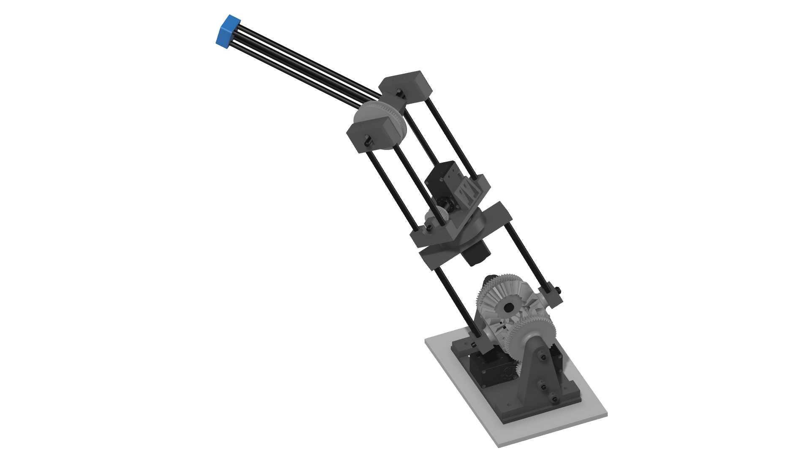
3D Printed Robotic Arm
Samuel Zeitler
Master Thesis
Chair of Autonomous Aerial Systems (Prof. Ryll)
Garching, 29. Januar 2024
Notes:
First of all, thank you for attending my master thesis presentation. I am Samuel, I study Mechantronics and Robotics at TUM.
This presentation might be a little unusual as my master thesis is a little unusual
Broad engineering project instead of in-depth academic research
About the development of a robotic arm prototype, aimed at aerial-manipulation
I have been working on this project for the past year now and today is the final day of that journey for me.
I want to start off with the full picture: History of the project

Slide 2
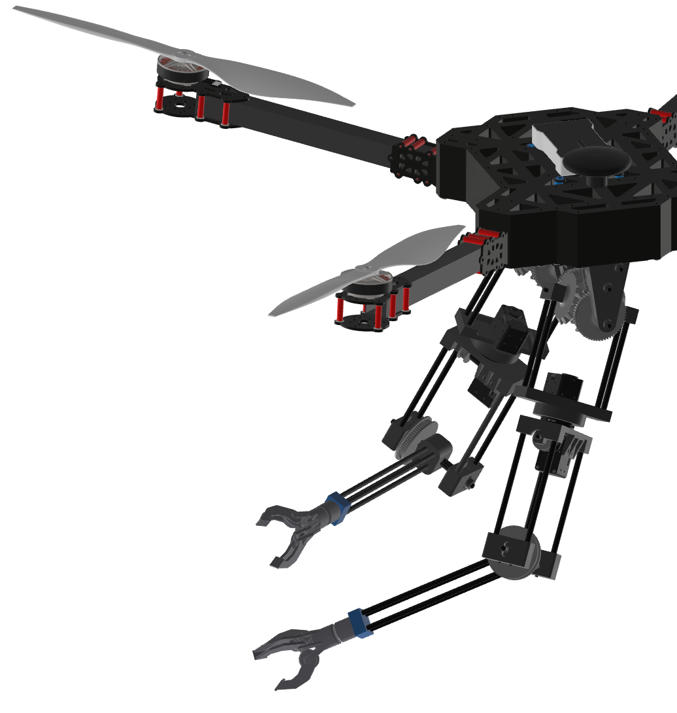
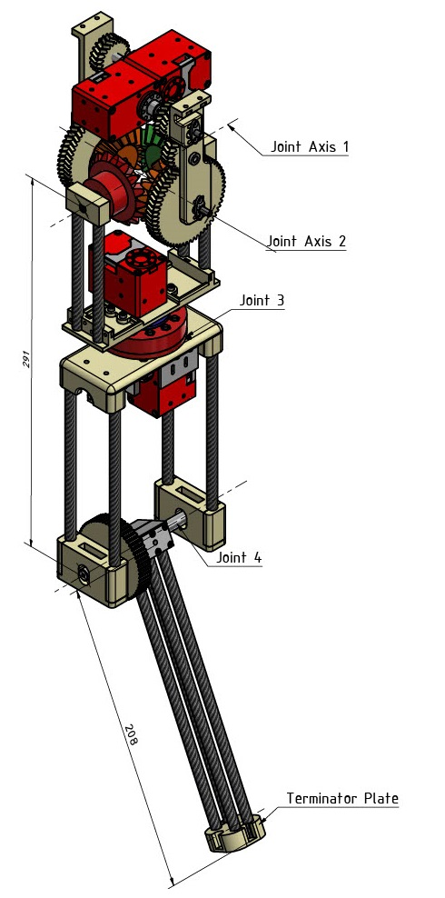
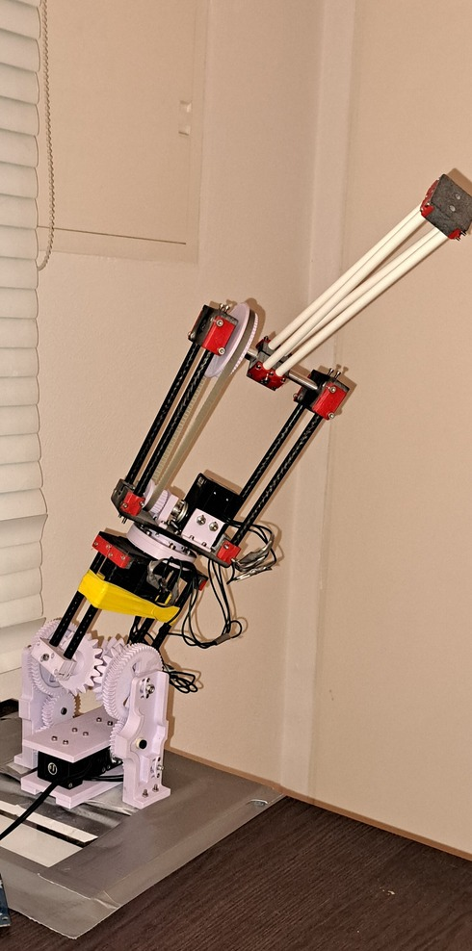
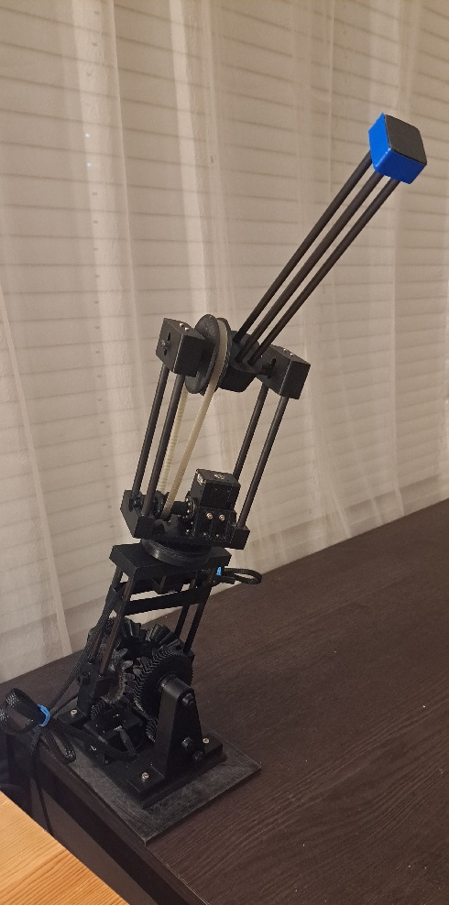
“Towards Dual-Arm Aerial Manipulation: An Exploration in Robotic Arm Design”
Zeitler
Sem. Thes. 2023
(…)
Sindermann
Sem. Thes. 2021
Zeitler
M. Thes. 2024
B.Sc. Samuel Zeitler
Notes:
The project started off in 2021: Vision to develop a UAV with two robotic arms
Since then, the project consisted of individual contributions by students at this chair
First Contribution: Jasper Sindermann: Blueprint of a single robotic arm.
Then in 2023, I was tasked with putting the blueprint intro practice and built the first protoype.
For my Master thesis, I completely rebuilt the prototype from the ground up, aimed at a more sophisticated result.
In this presentation I will highlight key aspects of the projects journey so far.

Slide 3
Foundational Work (J. Sindermann)
Formulating the Design Goal
Development of a 4-DOF Robotic Arm for a UAV
Formulating Requirements
Mass <= 1 kg, Length ~ 0.5 m
Kinematic and Dynamic Requirements
Defining the Kinematic Parameters
Configuration y – x – z – x
Shoulder Joint (1 + 2)
Yaw Joint (3)
Elbow Joint (4)
Optimized Link Lengths
Notes:
- Jasper Sindermann formulated the design goal of the project: Develop a 4-DOF …
He analyzed commercially available manipulators → derived requirements from that
Mass, Length
Kinematic Requirements describe how the arm should be able to move
Dynamic Requirements describe what forces the arm should be able to exert and withstand
The main part of his work was dedicated to defining finding the optimal kinematic parameter: The number and configuration of the joints and the optimized link lengths
Result: First Blueprint of the Robotic Arm Prototype

Slide 4
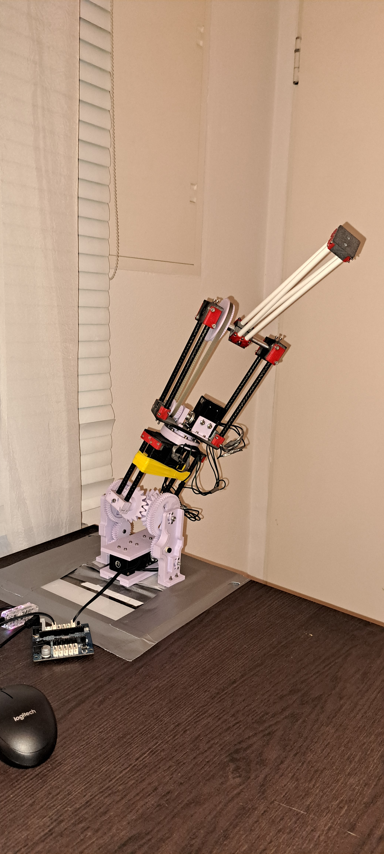
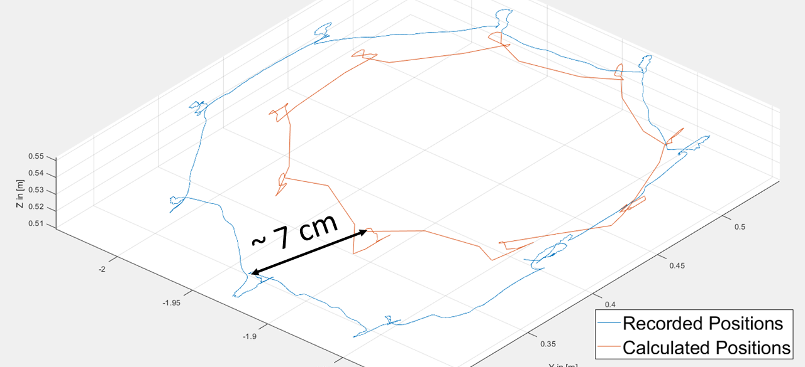
First Prototype (2023)
Challenges
Little Experience in 3D printing
Numerous delicate Parts
Iterative Dimensioning necessary (e.g. Axes and Gears)
Press-fitting printed Gears onto Aluminum Axes
Outcome
Time consuming Assembly Process
Low load-bearing Capacity of the Shoulder Joint
Imprecise Movements
Limited Software Functionality
Redesign necessary
Notes:
Building the first prototype was very challenging task for my semester thesis
Little Experience in 3D printing, The blueprint contained numerous delicate Parts …
To my surprise I was eventually able to build the first functioning prototype.
However, it had significant downsides like: A very time consuming assembly process…
The motion accuracy was analyzed in the Fligh Arena using the Motion ….
Large Deviations of where the prototype thinks its End Effector is vs. where it actually is
→ Not suitable for the project of aerial-manipulation
→ Redesign necessary

Slide 5
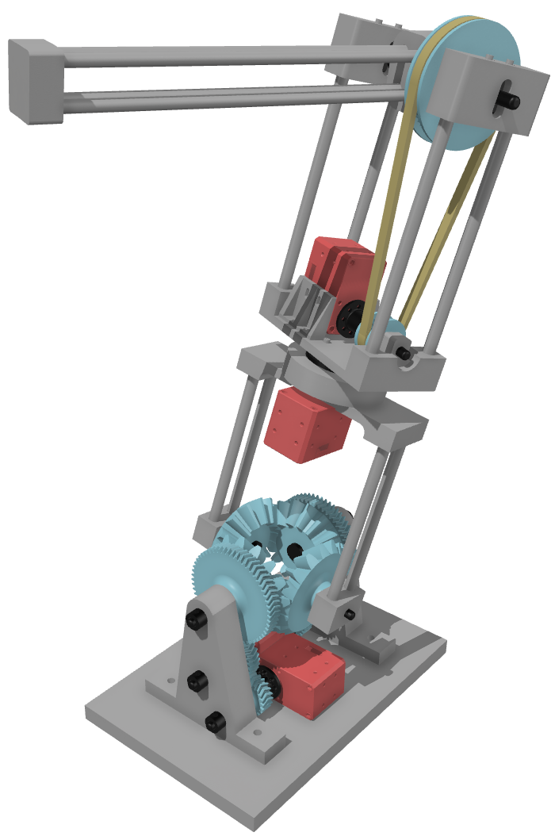
Second Prototype – Mechanical Redesign (1/2)
Reduction of Complexity
Simplified Component Geometries
Reduction of Part Count (esp. purchased Parts)
Screwing Connections replaced with Epoxy Resin
Redesigned Shoulder Joint
Larger Bevel Gears
Reinforced Side Braces
Increased clamping Force
B.Sc. Samuel Zeitler
Notes:
For Master Thesis I completely redesigned the prototype
The written part of the thesis documents the current state of the developed software and hardware to provide a foundation for future development
I will start off with presenting the Key Aspects of the Mechanical Redesign
The core philosophy to keep the project manageable was reduction of complexity
For the Mechanical design this meant: Simplified Component Geometries…
The previously weak shoulder Joint was improved by using: Larger Bevel Gears…
2-DOF Shoulder Joint was the weakest point of the previous prototype as it could ‘Dislocate’

Slide 6
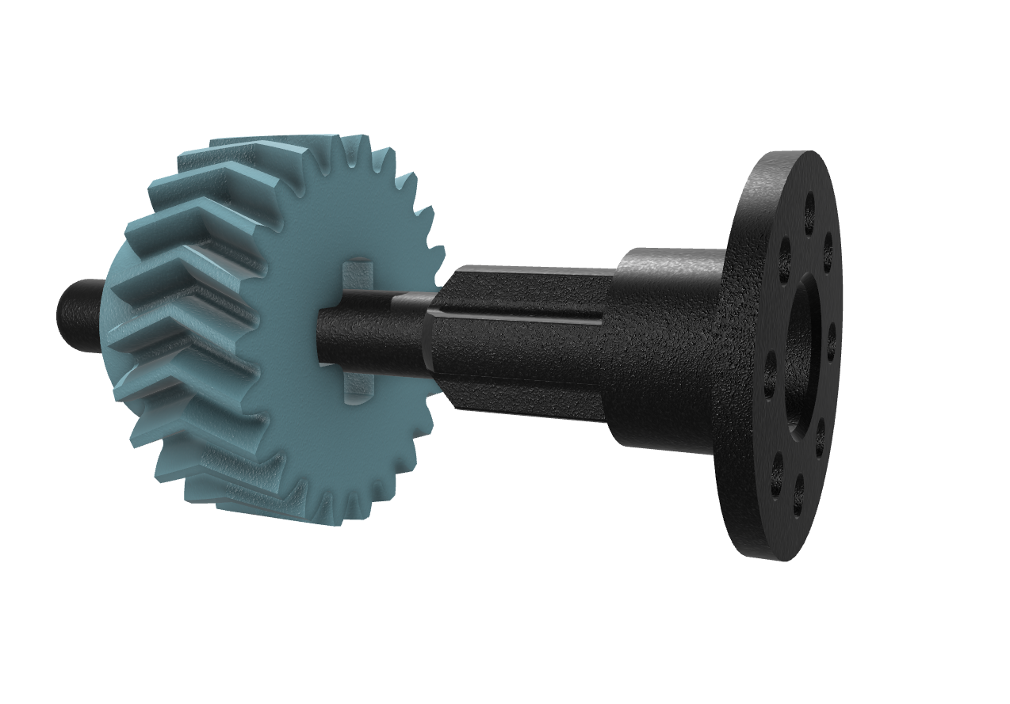
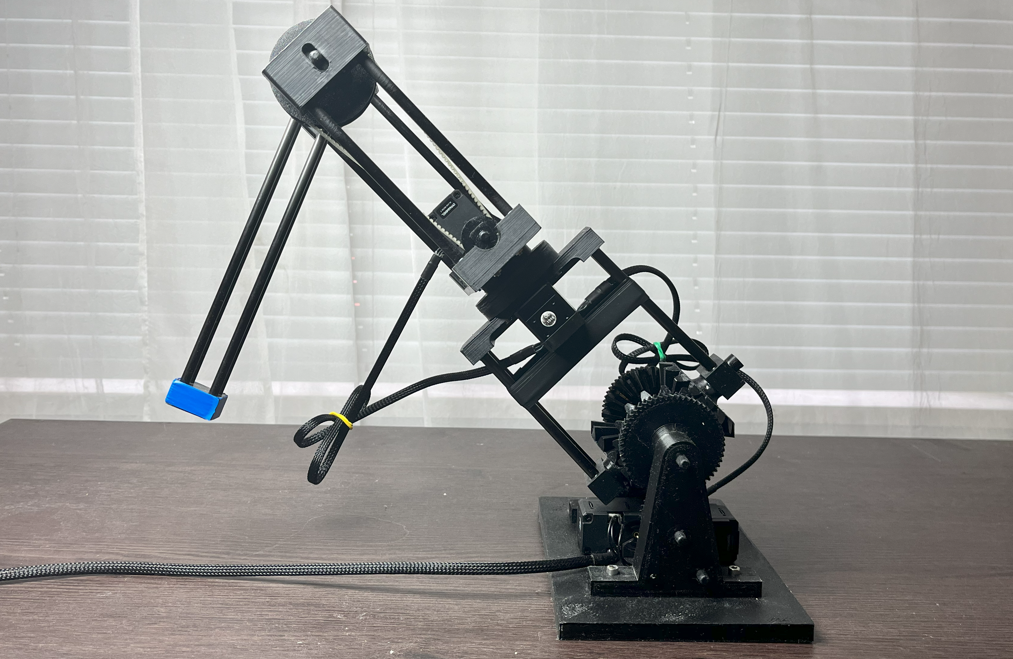
Second Prototype – Mechanical Redesign (2/2)
3D printed Axes
Made possible by stronger PETG Filament
Eliminated the Need for milling Aluminum Parts
Fast Prototyping and Replacement of broken Parts
Outcome
Streamlined Manufacturing and Assembly Process
Reduced mechanical Backlash
Increased load-bearing Capacity
Mechanical Resilience
B.Sc. Samuel Zeitler
Notes:
A key design choice was the switch from aluminum milled axes to 3D printed Axes
This was made possible by printing with PETG Filament instead of PLA
PETG is stronger and more durable then PLA, especially with the correct layer orientation
This allowed fast prototyping and quick replacement of broken Parts
The finished prototype can be seen here infront of me
It has a significantly less complex manufacturing and assembly process…

Slide 7
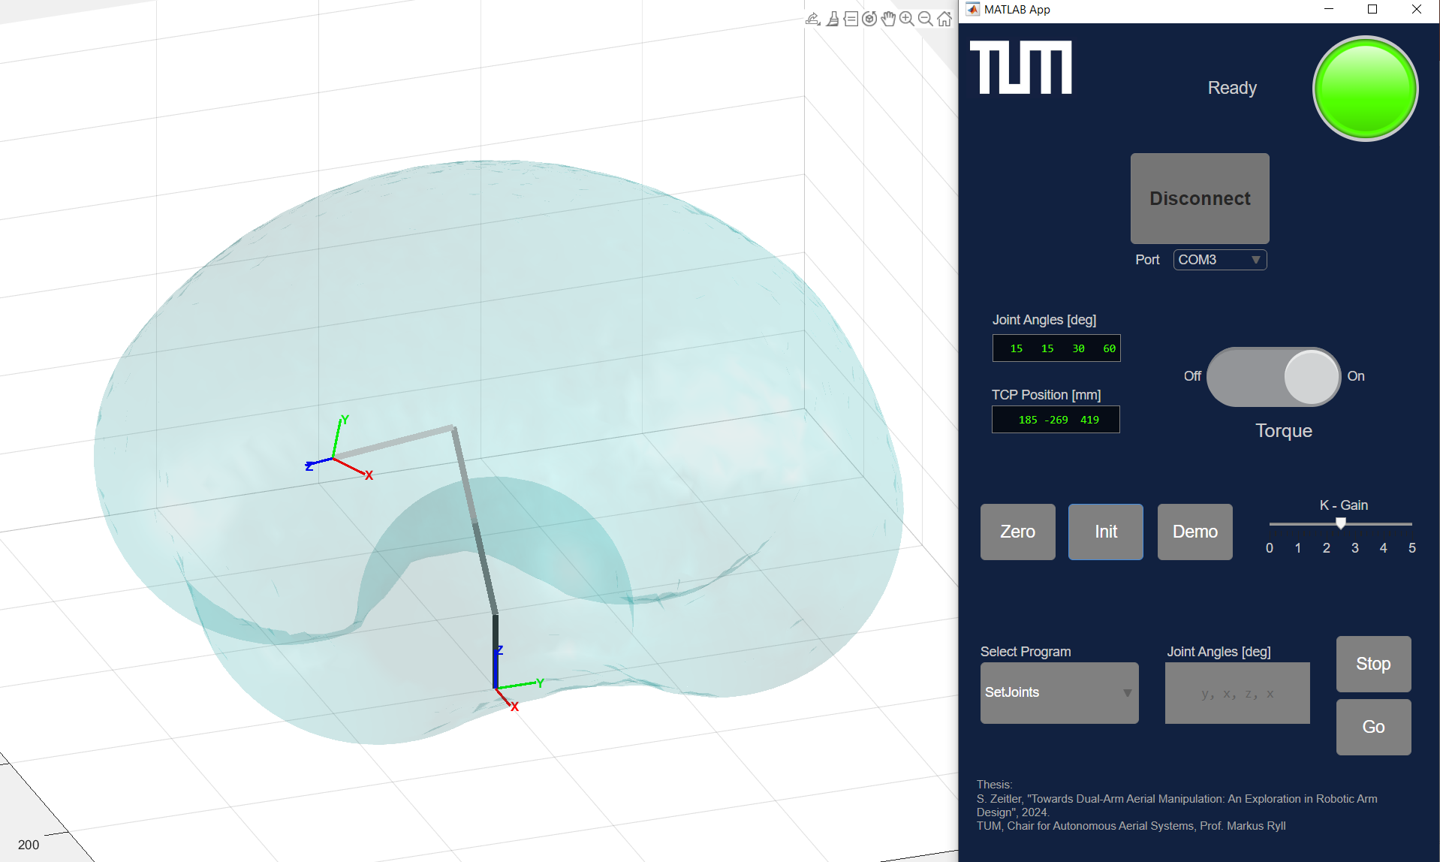
Second Prototype – Software
Notes:
- The development of the new hardware was only a minor part of the work, compared to the development of the software
The software of the robotic arm is used for controlling and visualizing the robotic arm from a PC
The screenshot shows…. Will be demonstrated live in a minute….

Slide 8
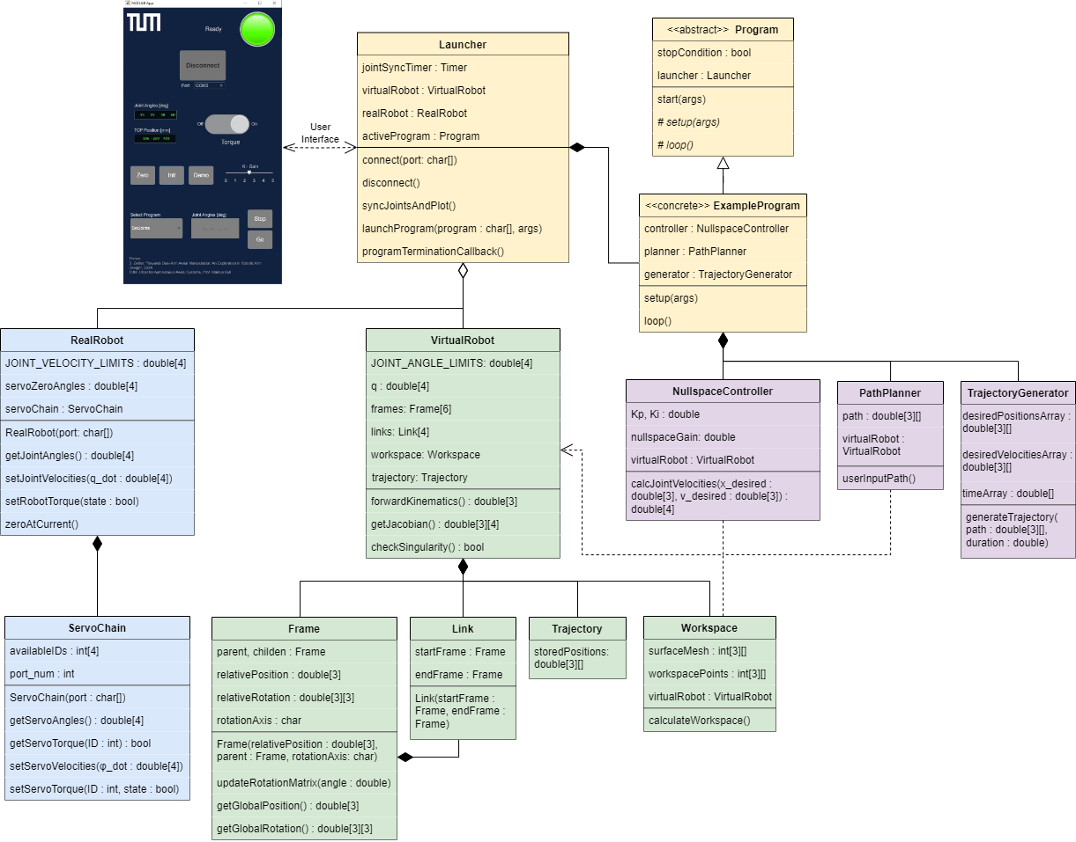
Software – Overview (UML – Diagram)
Notes:
- The software is built using object oriented programming and can be represented as a UML Diagram
- The Classes are grouped based on their functionality and are highlighted using different colors
The blue group is the interface with the real robotic arm…
The green group is the kinematic model
The purple group contains the controller, path planner and trajectory generator
And so on.
The complete code base is available in the github repository and documented in the master thesis
To keep it concise I want to highlight only a couple of key components of the software

Slide 9
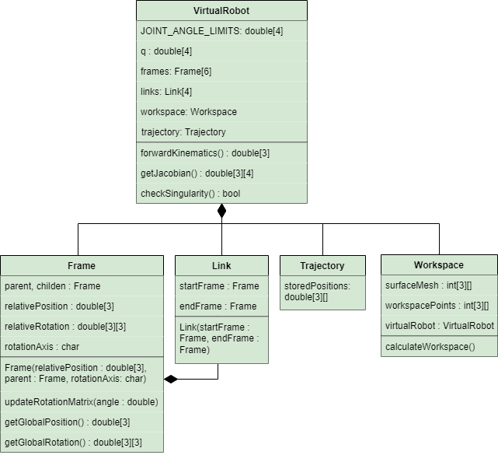
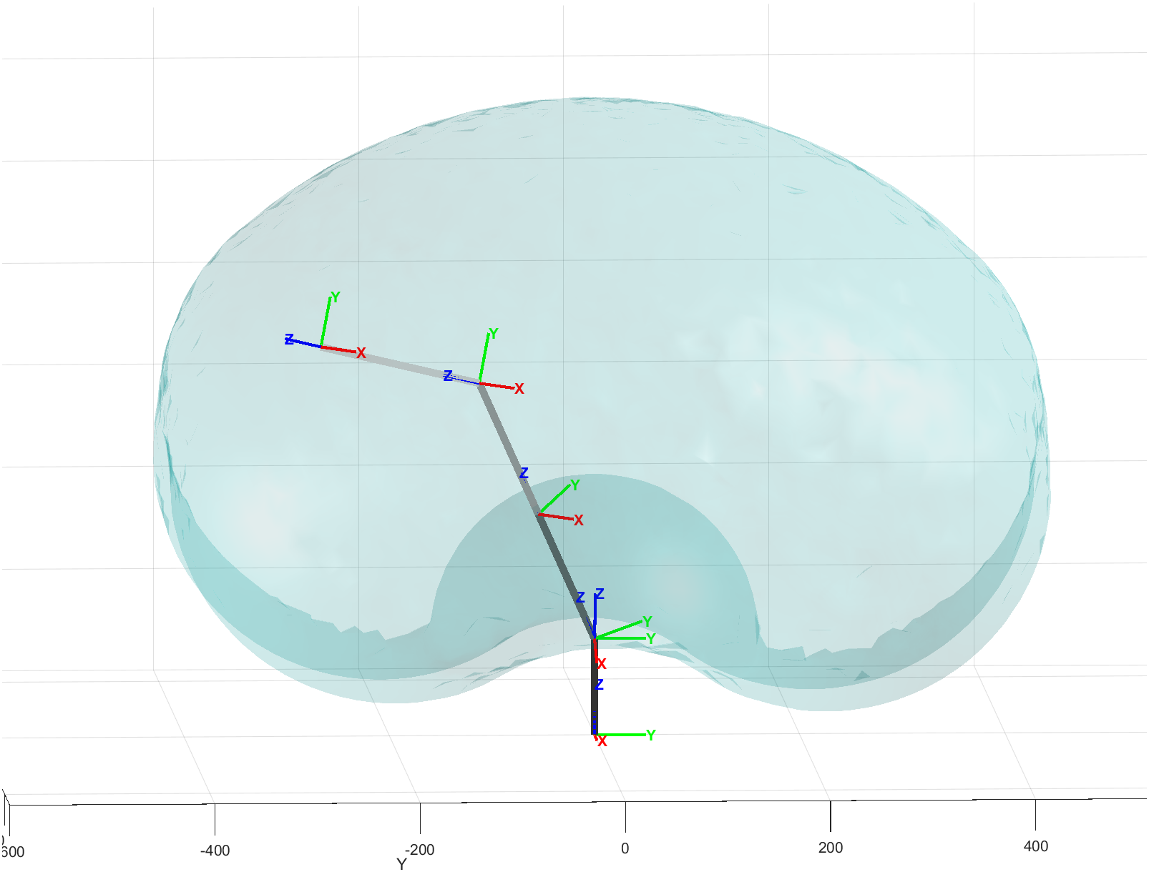
Key Component – VirtualRobot
Kinematic Model of the Robotic Arm, composed of:
Frames
Links
Workspace
Used for:
Computing forward + inverse Kinematics
Visualizing the Real Robot
Kinematic Simulations
Workspace
TCP
Joint 4
Joint 3
Joint 1 + 2
B.Sc. Samuel Zeitler
Origin
Notes:
The first key component I want to showcase is the Kinematic Model (green)
At the heart of the kinematic model is the VirtualRobot. A kinematic representation of the real robotic arm (See image)
It consists of …. FRAMES = Representation of a Coordinate System (e.g. Joints)
The kinematic model is necessary for….

Slide 10
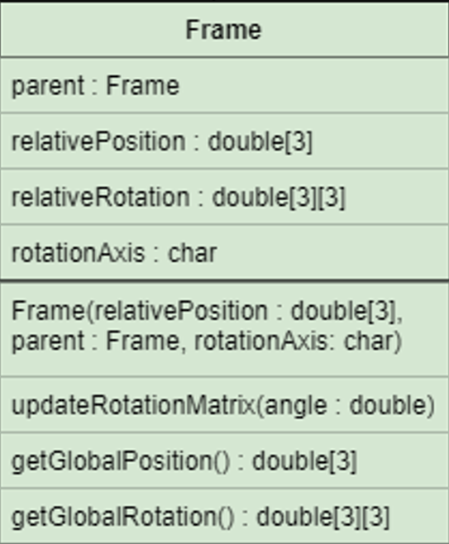
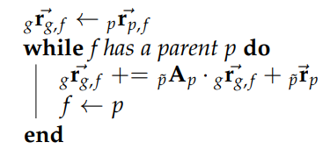
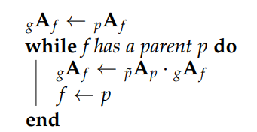
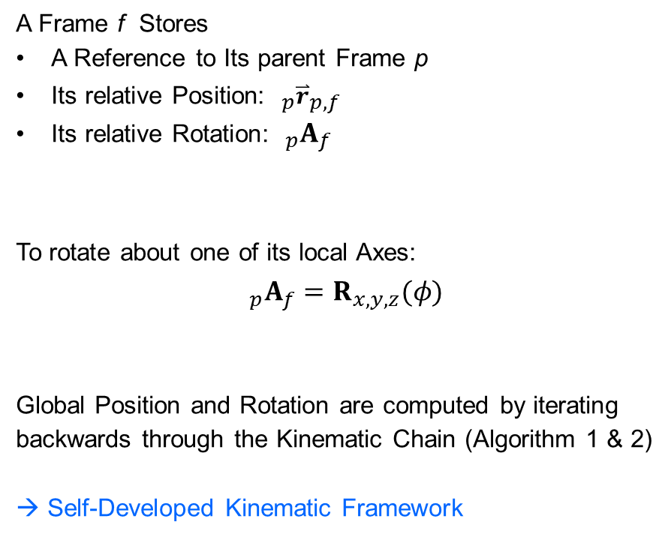
Core Concept – Frame Class
A Frame f Stores
A Reference to Its parent Frame p
Its relative Position: $_{p}{\overset{⃑}{r}}_{p,f}$
Its relative Rotation: $_{p}A_{f}$
To rotate about one of its local Axes: $$_{p}A_{f}=R_{x,y,z}(φ)$$
Global Position and Rotation are computed by iterating backwards through the Kinematic Chain (Algorithm 1 & 2)
→ Self-Developed Kinematic Framework
Algorithm 1: Compute Global Position
Algorithm 2: Compute Global Rotation
B.Sc. Samuel Zeitler
Notes:
The Core concept of the Kinematic Model is the Frame class
A Frame is used to model the kinematically linked joints of the robotic arm
This class contains all the necessary coordinate transform computations
In this concise implementation a Frame f must only Store…..
It can the rotate about one of its local axes by setting the stored Rotation matrix to an elemtary rotation matrix with the corresponding angle phi
the gloal position and rotation of the frame are computed by…
→ Self-Developed Kinematic Framework (inspired by ROS tf )

Slide 11
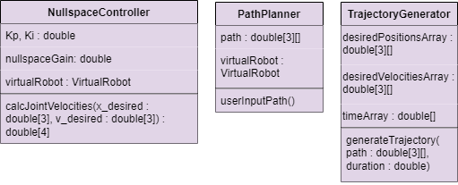
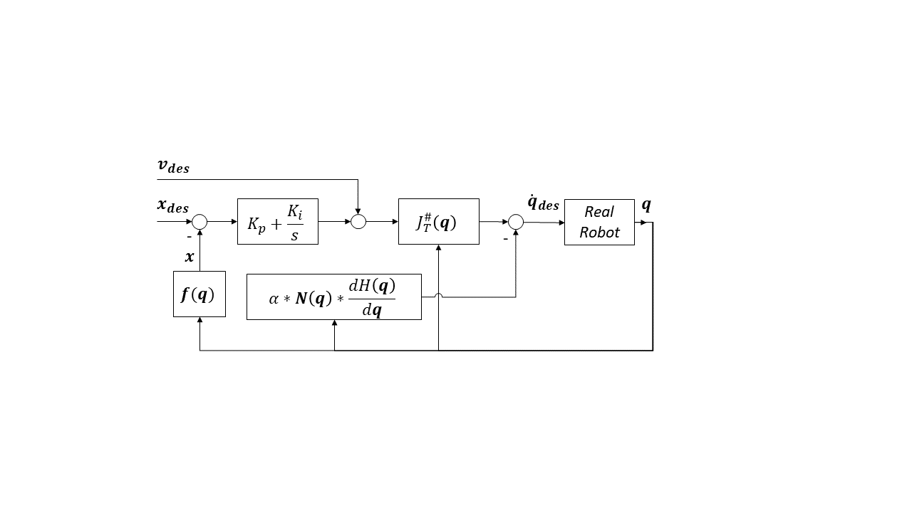
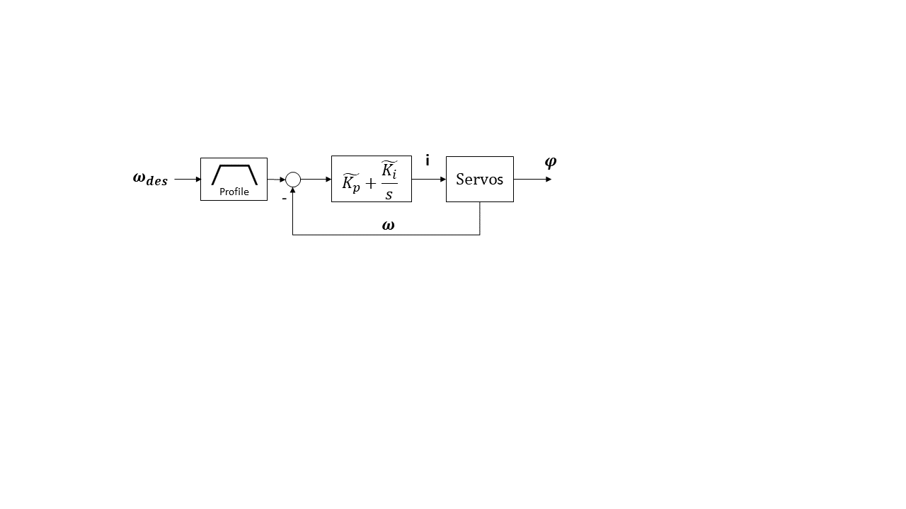
Key Component – Controller
Main Controller
Task Space
End Effector Trajectory Control
Running on PC, ~ 50 Hz (“slow timescale“)
Servo Controller
Joint Space
Velocity Control
Running on Servos, > 1kHz (“fast timescale“)
→ Decoupled, Cascaded Control Structure
Task Space Control
Joint Space Control
B.Sc. Samuel Zeitler

Slide 12
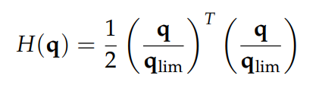
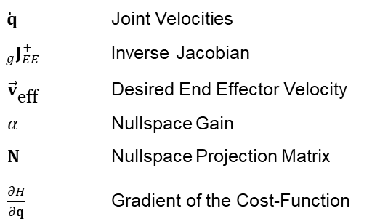
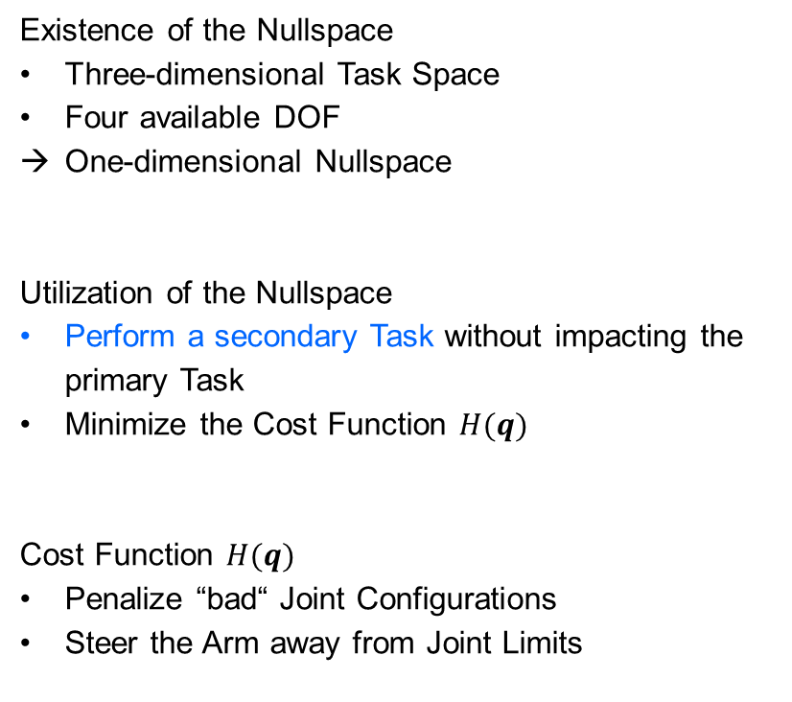
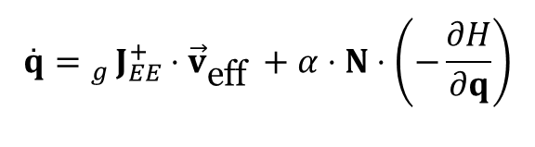
Nullspace Utilization
$$\overset{˙}{q}= _{g}J_{EE}^{+}⋅{\vec{v}}_{\text{eff} }+α⋅N⋅\left(−\frac{∂H}{∂q}\right)$$
Existence of the Nullspace
Three-dimensional Task Space
Four available DOF
One-dimensional Nullspace
Utilization of the Nullspace
Perform a secondary Task without impacting the primary Task
Minimize the Cost Function $H(q)$
Cost Function $H(q)$
Penalize “bad“ Joint Configurations
Steer the Arm away from Joint Limits
Primary Task
Secondary Task
$\overset{˙}{ q}$ Joint Velocities
$_{g}J_{EE}^{+}$ Inverse Jacobian
${\vec{v}}_{\text{eff} }$ Desired End Effector Velocity
$α$ Nullspace Gain
$N$ Nullspace Projection Matrix
$\frac{∂H}{∂q}$ Gradient of the Cost-Function
B.Sc. Samuel Zeitler

Slide 13
3D Printed Robotic Arm
Live-Demo

Slide 14
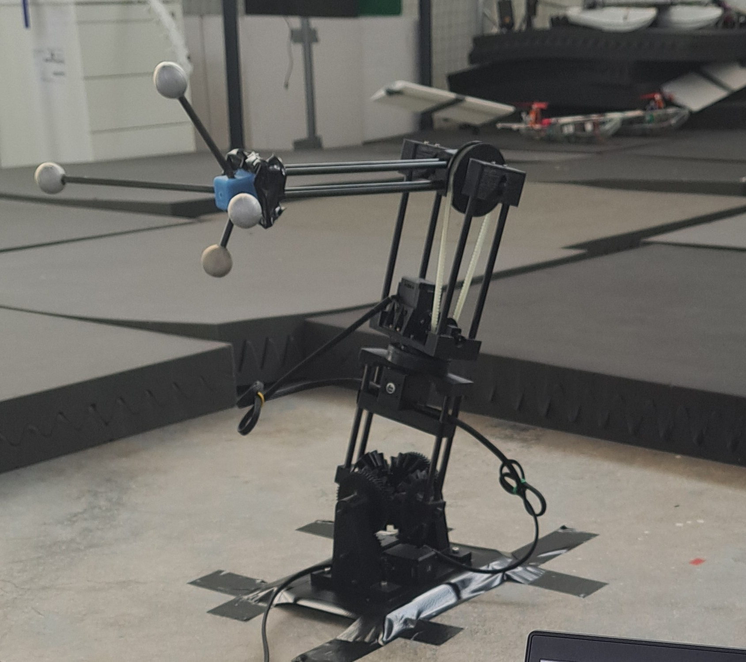
Evaluation – Motion Accuracy Testing (1/2)
Task: Follow a Circular End Effector Trajectory
Diameter = 30 cm
Time = 10 s
Measurements:
Desired Trajectory
Calculated Trajectory
Recorded Trajectory
Calculated Trajectory = The internal Estimate of the End Effector Position based on the measured Servo Angles and the Kinematic Model
Robotic Arm equipped with Infrared Markers

Slide 15
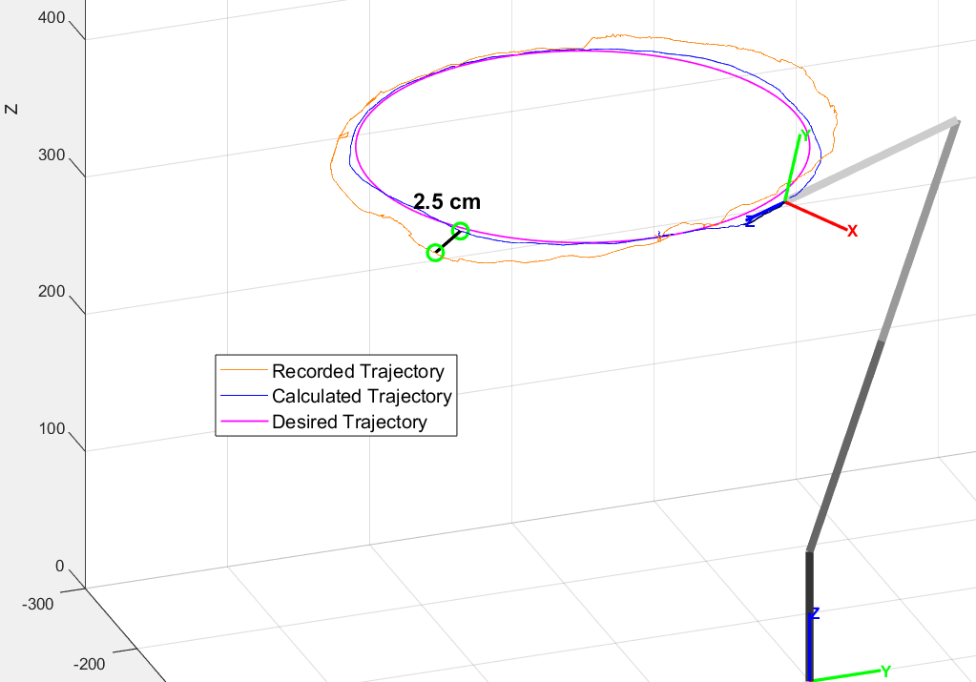
Evaluation – Motion Accuracy Testing (2/2)
Analysis of the Deviations Between:
Desired (m) and Calculated Trajectory (b)
Controller Tracking Error
Small and uniform
Origin: Low Controller Frequency (50 Hz)
Calculated (b) and recorded Trajectory (o)
Estimation Error of the End Effector Position
Average: 1 cm; Maximum 2.5 cm
Origin: Manual Calibration; Backlash
→ Higher Accuracy compared to previous Prototype

Slide 16
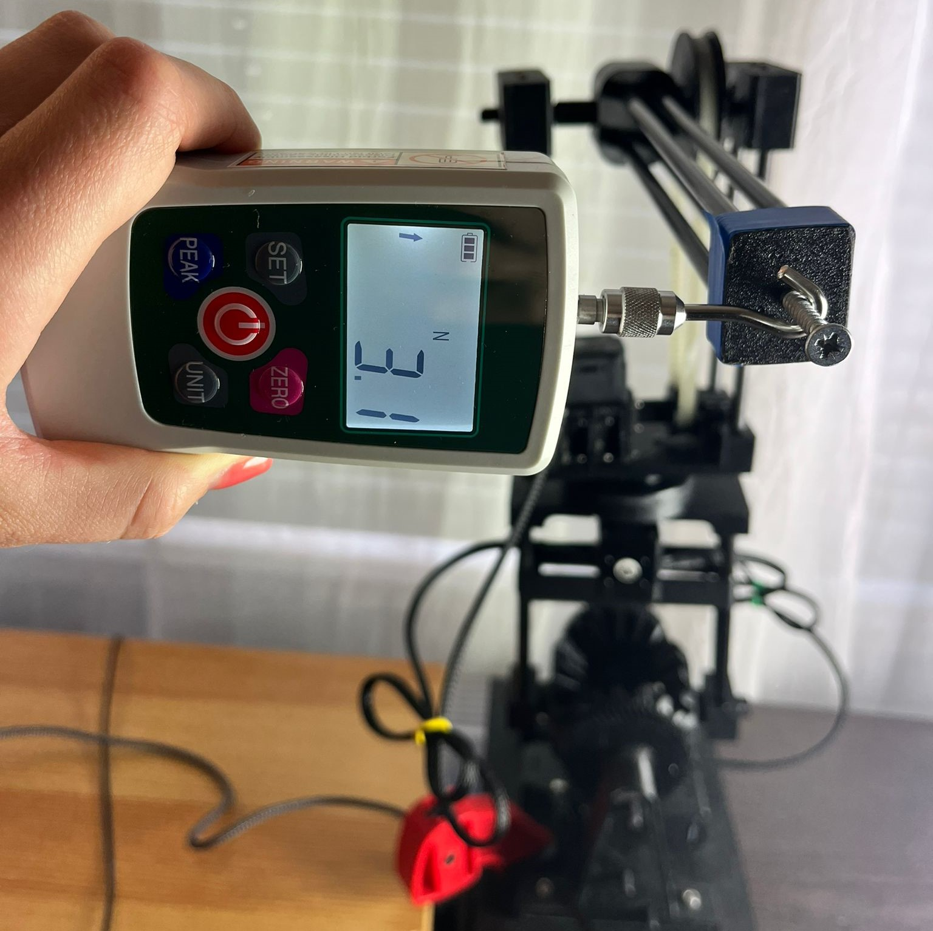
Evaluation – Force Exertion Testing (1/2)
Task: Exert a static Force at the End Effector
Test Setup
End Effector is linked to a Force Gauge
Direction of Movement is blocked
Progressive increase in Torque until a Servo reaches the Overload State
Repeated for different Joint Configurations
Measurement: Maximum Force Output at the End Effector

Slide 17
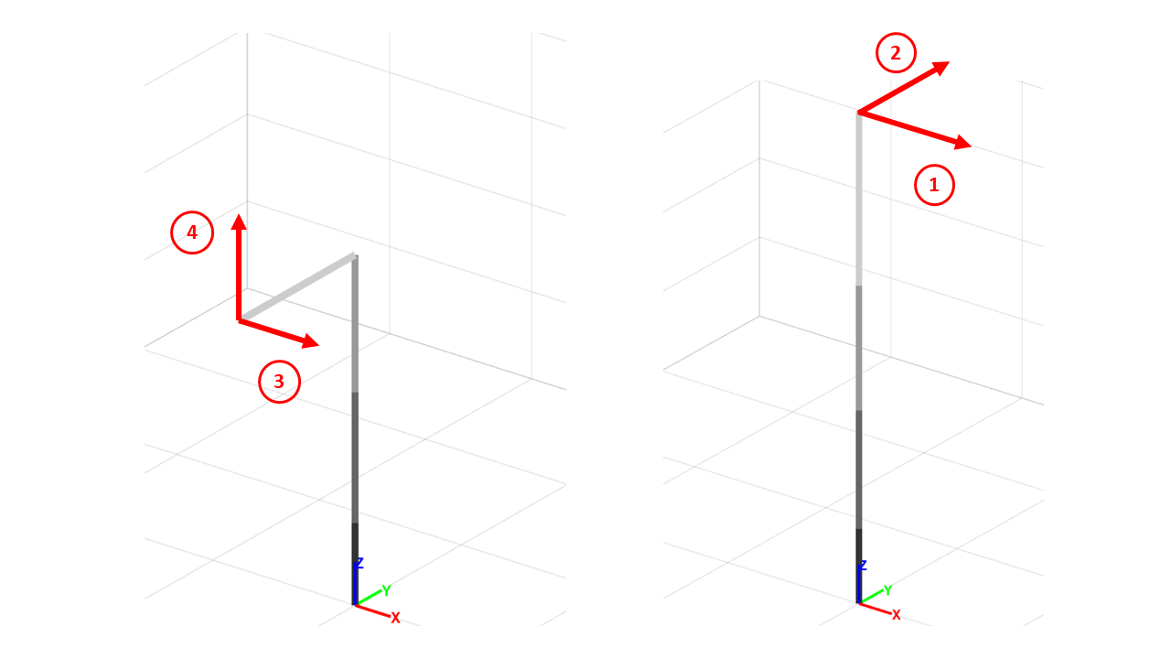
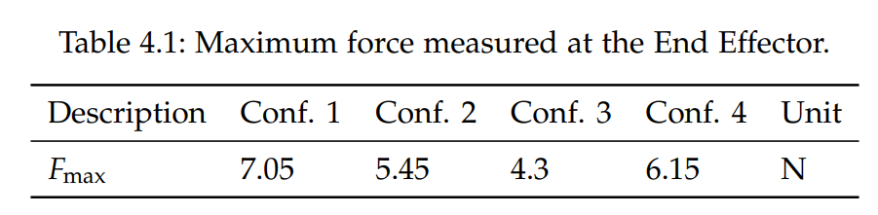
Evaluation – Force Exertion Testing (2/2)
Configurations are worst-case Conditions
Maximum torque at a single joint
Maximum lever-arm
Test Findings:
Prototype meets Dynamic Requirement of 3 N in every configuration
Hardware withstood the operational forces
Stall-Torque of Servos lower then specified
→ Increased Strength compared to previous Prototype

Slide 18
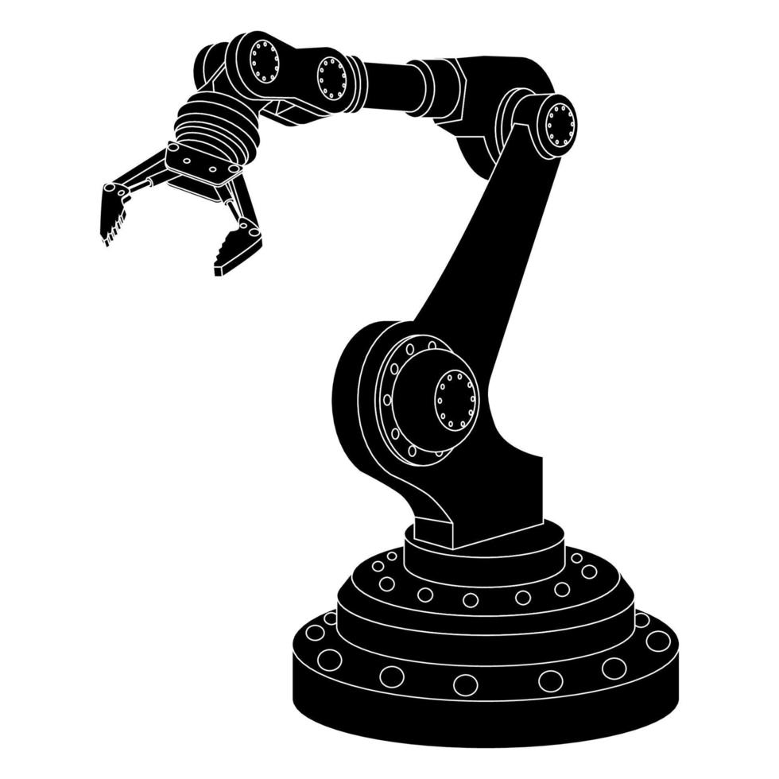
Conclusion
Sindermann
Zeitler
Progression towards Aerial-Manipulation
Requirements fulfilled
Reliable Soft- and Hardware
Inexpensive Manufacturing
Weight: 951 g
Approaches to Future Work
Migrating the Main Controller (ROS)
Exploring Torque Control
Exploring Dual-Arm Control
→ Handover to the next Student
…
Zeitler

Slide 19
Thank you for your Attention! Any Questions?

